Slide 1
Installing VirtualBox on Windows 10
Download VirtualBox installer for Windows
Go to https://www.virtualbox.org/wiki/Downloads to download the binary version for Windows hosts
Run the executable and follow the Wizard prompts

Slide 2
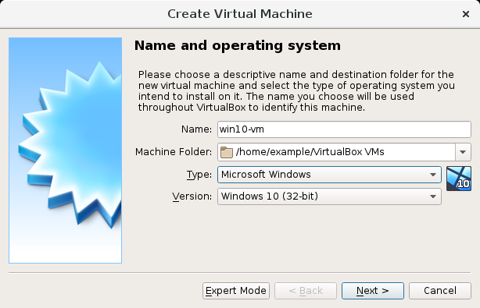
Creating a Virtual Machine
Click New in the VirtualBox Manager window. A wizard will guide you through setting up a new virtual machine (VM).
The Name of the VM will later be shown in the machine list of the VirtualBox Manager window.
The Machine Folder is the location where VMs are stored on your computer.
For Operating System Type select the OS that you want to install later.
On the next page, select the Memory (RAM) that Oracle VM VirtualBox should allocate every time the virtual machine is started.

Slide 3
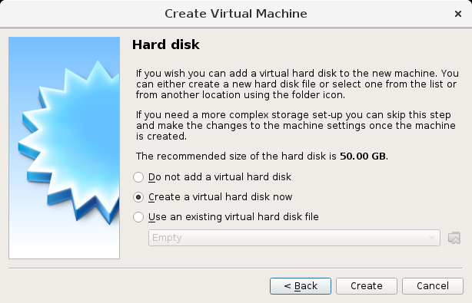
To create a new, empty virtual hard disk, click the Create button.
You can pick an existing disk image file.
The drop-down list presented in the window lists all disk images which are currently remembered by Oracle VM VirtualBox. These disk images are currently attached to a virtual machine, or have been attached to a virtual machine.
Alternatively, click on the small folder icon next to the drop-down list. In the displayed file dialog, you can click Add to select any disk image file on your host disk.

Slide 4
Installing VirtualBox
VirtualBox is a general-purpose full virtualizer for x86 hardware, targeted at server, desktop and embedded use.
You can use VirtualBox to install different types of operating systems on your native operating system.
For example, if my computer is running the Windows 10 operating system, I can install and run the Ubuntu operating system on top of Windows 10 as a virtual machine.
Go to http://https://www.virtualbox.org/
Click on the download box to download the latest version (e.g. version 6.0)

Slide 5
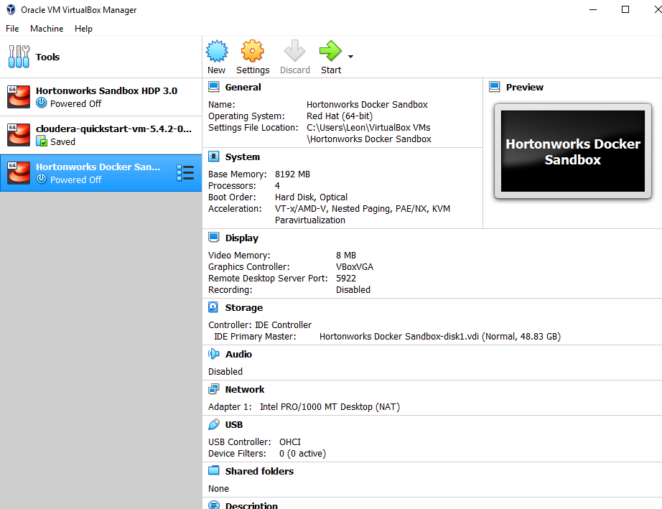

Slide 6
Installing Ubuntu on VirtualBox
Ubuntu is a complete Linux operating system, freely available with both community and professional support.
Go to https://ubuntu.com/download/desktop to download the ISO system image of Ubuntu, e.g. ubuntu-18.04.3-desktop-amd64.iso (approximately 2 GB)
Recommended system requirements:
2 GHz dual core processor or better
4 GB system memory
25 GB of free hard drive space

Slide 7
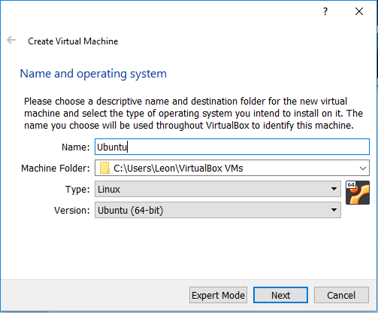
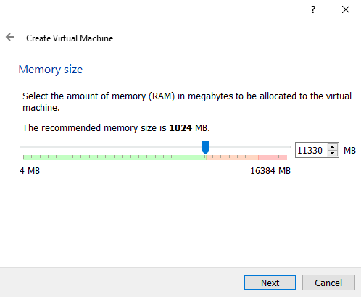
Run VirtualBox.
Click on the New button and fill in the required fields as shown.
Specify the memory size.

Slide 8
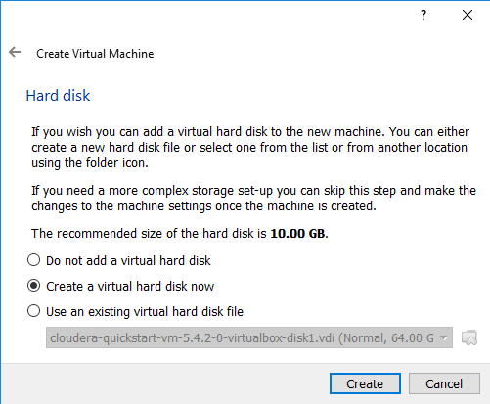
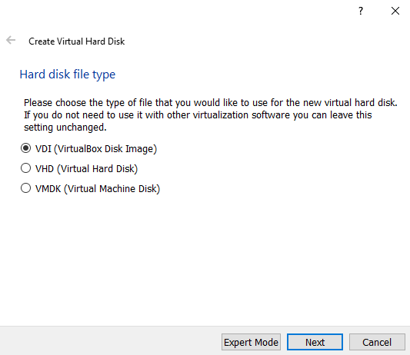
Accept the default option for the hard disk: Create a virtual hard disk file, then click Create.
Accept the default value for the hard disk file type: VDI (Virtual Disk Image), then click Next.

Slide 9
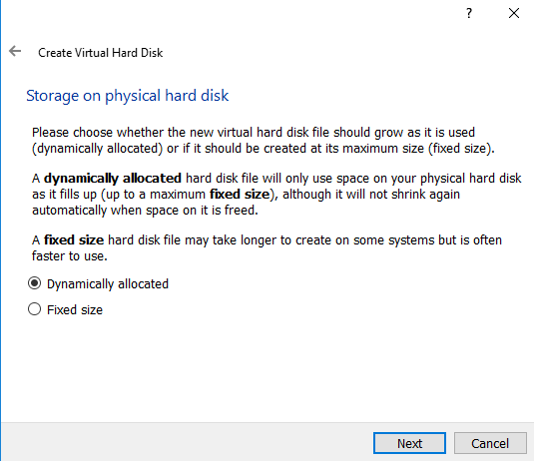
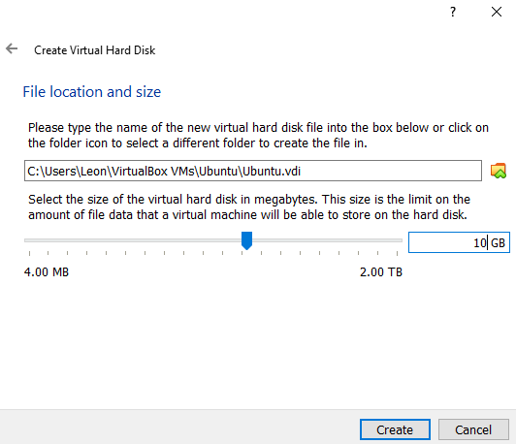
Accept the default value for storage on physical hard disk: Dynamically allocated.
Accept the file location for the virtual hard disk
Adjust the size of the virtual hard disk according to needs.
Click Create.

Slide 10
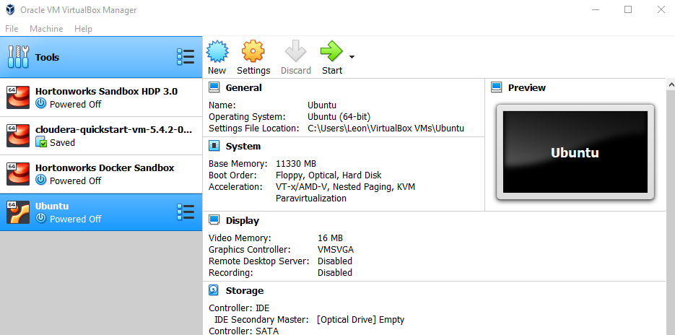
You should see the new entry for the Ubuntu system displayed on the VirtualBox window.

Slide 11
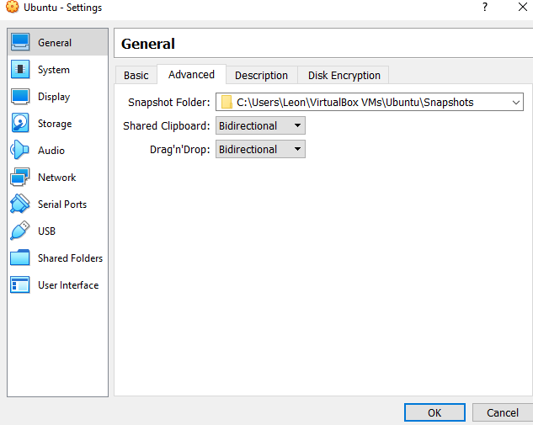
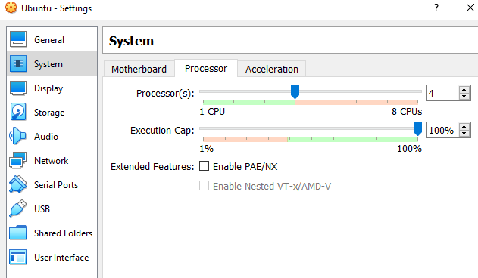
With the Ubuntu system selected in VirtualBox, click on the Settings icon.
Click on the Advanced tab.
Change the values for Shared Clipboard and Drag’n’Drop to Bidirectional. This will allow you to copy and paste using the clipboard from your host machine to your virtual machine.
Click on System → Processor. You can choose the number of processors that the system can use.

Slide 12
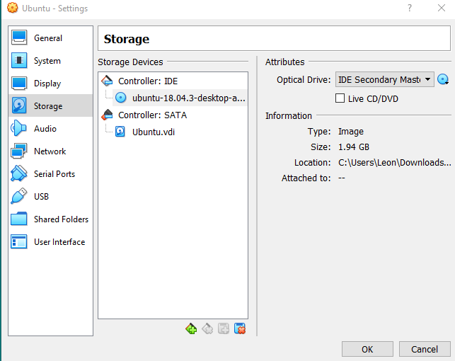
Click on Storage → Empty (under Controller: IDE)
Click on the disk icon (on the right) and select choose Virtual Optical Disk File … from the menu.
Navigate and select the ISO image file of Ubuntu that you downloaded earlier.
Click OK.

